Slide 1
EEE tutorial questions
I will try my best to answer all of them…

Slide 2
Tutorial 2

Slide 3
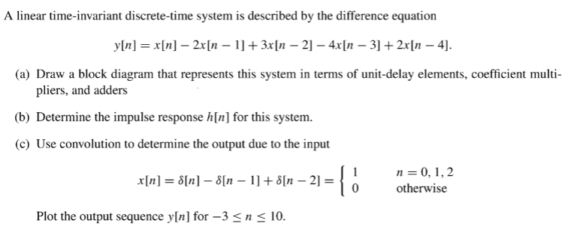

Slide 4
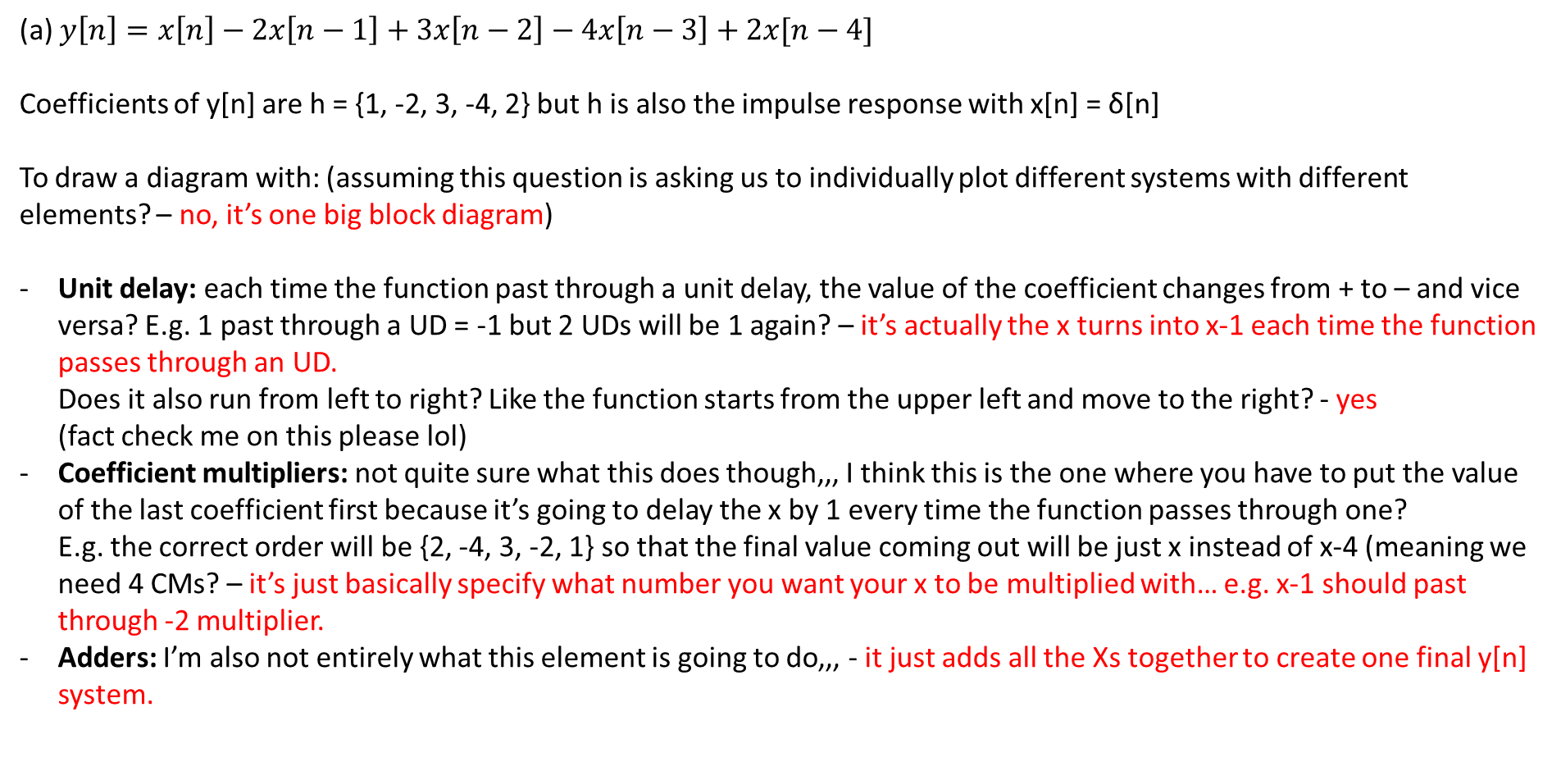
(a) $y\left[n\right]=x\left[n\right]−2x\left[n−1\right]+3x\left[n−2\right]−4x\left[n−3\right]+2x[n−4]$
Coefficients of y[n] are h = {1, -2, 3, -4, 2} but h is also the impulse response with x[n] = δ[n]
To draw a diagram with: (assuming this question is asking us to individually plot different systems with different elements? – no, it’s one big block diagram)
Unit delay: each time the function past through a unit delay, the value of the coefficient changes from + to – and vice versa? E.g. 1 past through a UD = -1 but 2 UDs will be 1 again? – it’s actually the x turns into x-1 each time the function passes through an UD. Does it also run from left to right? Like the function starts from the upper left and move to the right? - yes (fact check me on this please lol)
Coefficient multipliers: not quite sure what this does though,,, I think this is the one where you have to put the value of the last coefficient first because it’s going to delay the x by 1 every time the function passes through one? E.g. the correct order will be {2, -4, 3, -2, 1} so that the final value coming out will be just x instead of x-4 (meaning we need 4 CMs? – it’s just basically specify what number you want your x to be multiplied with… e.g. x-1 should past through -2 multiplier.
Adders: I’m also not entirely what this element is going to do,,, - it just adds all the Xs together to create one final y[n] system.

Slide 5


-
Unit delay
-2
Coefficient multiplier
+
Adders
$$x[n]$$
-
-
-
$$y[n]$$
-
1
-2
3
-4
2
+
+
+
+
+
$$y\left[n\right]=x\left[n\right]−2x\left[n−1\right]+3x\left[n−2\right]−4x\left[n−3\right]+2x[n−4]$$

Slide 6
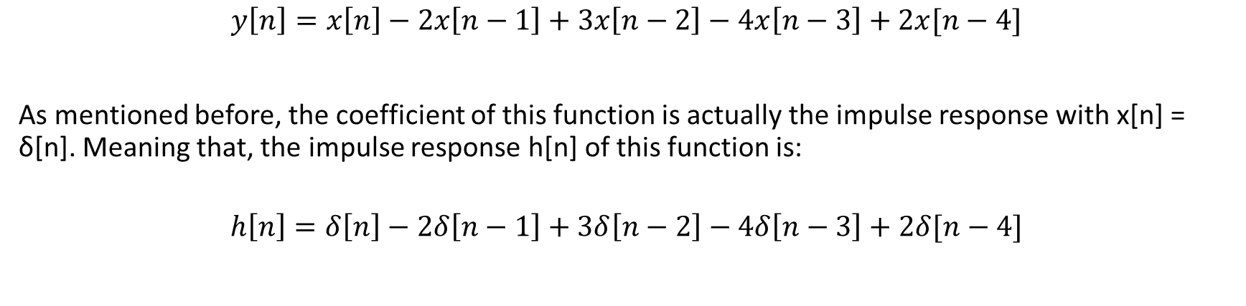
(b) Determine the impulse response h[n] of this function
$$y\left[n\right]=x\left[n\right]−2x\left[n−1\right]+3x\left[n−2\right]−4x\left[n−3\right]+2x[n−4]$$
As mentioned before, the coefficient of this function is actually the impulse response with x[n] = δ[n]. Meaning that, the impulse response h[n] of this function is:
$$h\left[n\right]=δ\left[n\right]−2δ\left[n−1\right]+3δ\left[n−2\right]−4δ\left[n−3\right]+2δ[n−4]$$

Slide 7
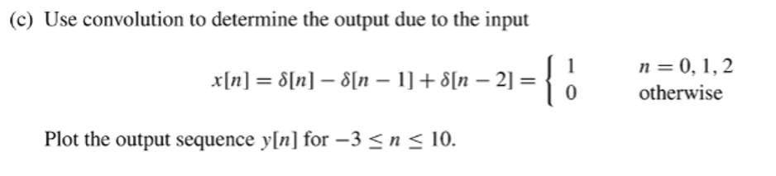
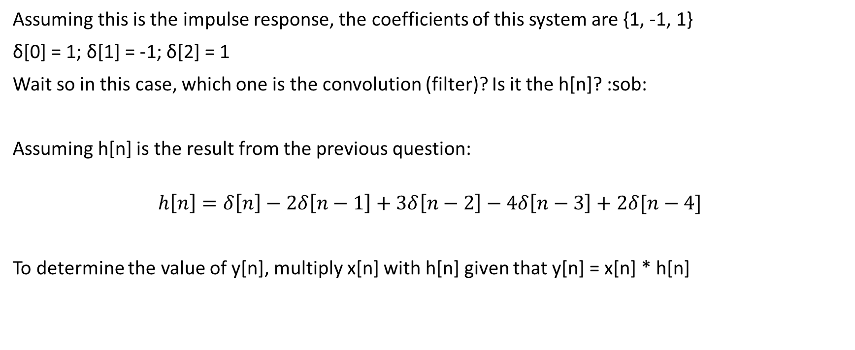
Assuming this is the impulse response, the coefficients of this system are {1, -1, 1}
δ[0] = 1; δ[1] = -1; δ[2] = 1
Wait so in this case, which one is the convolution (filter)? Is it the h[n]? :sob:
Assuming h[n] is the result from the previous question:
$$h\left[n\right]=δ\left[n\right]−2δ\left[n−1\right]+3δ\left[n−2\right]−4δ\left[n−3\right]+2δ[n−4]$$
To determine the value of y[n], multiply x[n] with h[n] given that y[n] = x[n] * h[n]

Slide 8
$$h\left[n\right]=δ\left[n\right]−2δ\left[n−1\right]+3δ\left[n−2\right]−4δ\left[n−3\right]+2δ[n−4]$$
New range = L1 + L2 – 1 = 3 + 4 – 1 = 6 -> test from n = 0 to n = 6
n | x[n] | h[n] | x[n] * h[n]
-3 | 0 | 0 | 0
-2 | 0 | 0 | 0
-1 | 0 | 0 | 0
0 | 1 | 1 | 1
1 | -1 | -2 | X[1]h[0] + x[0]h[1] = -1*1 + 1*(-2) = -1 -2 = -3
2 | 1 | 3 | X[2]h[0] + x[1]h[1] + x[0]h[2] = 1 + 2 + 3 = 6
3 | 0 | -4 | X[3]h[0] + x[2]h[1] + x[1]h[2] + x[0]h[3] = -2 + (-1)3 + 1*(-4) = -9
4 | 0 | 2 | x[2]h[2] + x[1]h[3] + x[0]h[4] = 1*3 + (-1)*(-4) + 1*2 = 9
5 | 0 | 0 | x[2]h[3] + x[1]h[4] = 1*(-4) + (-1)*2 = -6
6 | 0 | 0 | x[2]h[4] = 1*2 = 2
7 | 0 | 0 | 0
8 | 0 | 0 | 0
9 | 0 | 0 | 0
10 | 0 | 0 | 0

Slide 9
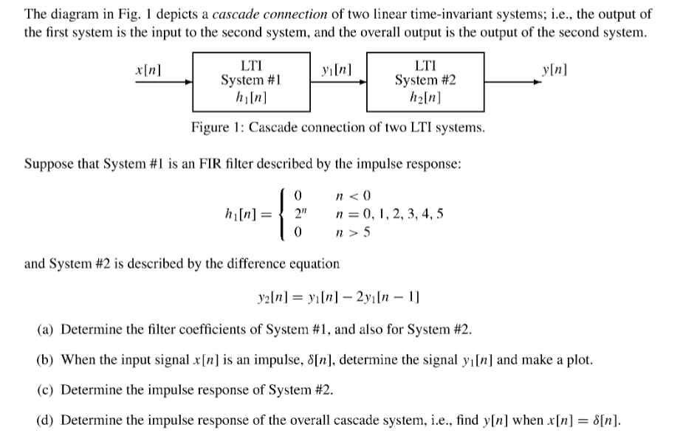

Slide 10
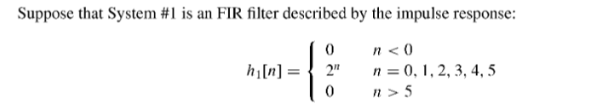

System 1:
h₁[n] coefficients = {1, 2, 4, 8, 16, 32}
-> h₁[n] = δ[n] + 2δ[n-1] + 4δ[n-2] + 8δ[n-3] + 16δ[n-4] + 32δ[n-5]
System 2:
y₂[n] coefficients = {1, 2, 4, 8, 16, 32}
-> h₁[n] = δ[n] + 2δ[n-1] + 4δ[n-2] + 8δ[n-3] + 16δ[n-4] + 32δ[n-5]
The rest of the solution is in the notebook

Slide 11
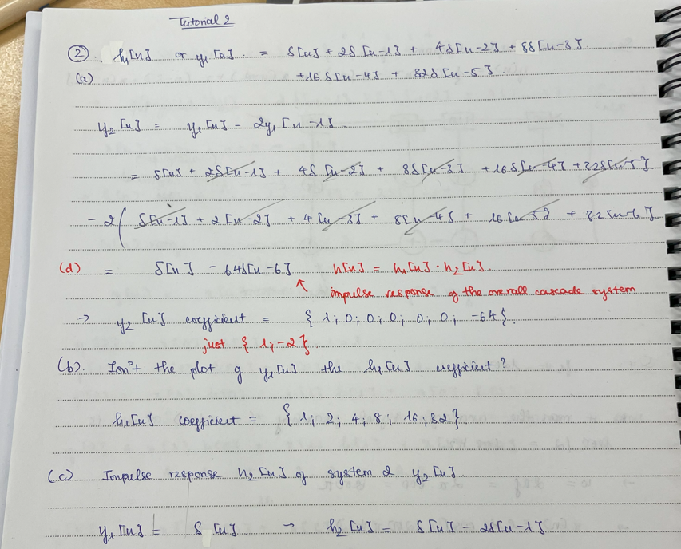

Slide 12
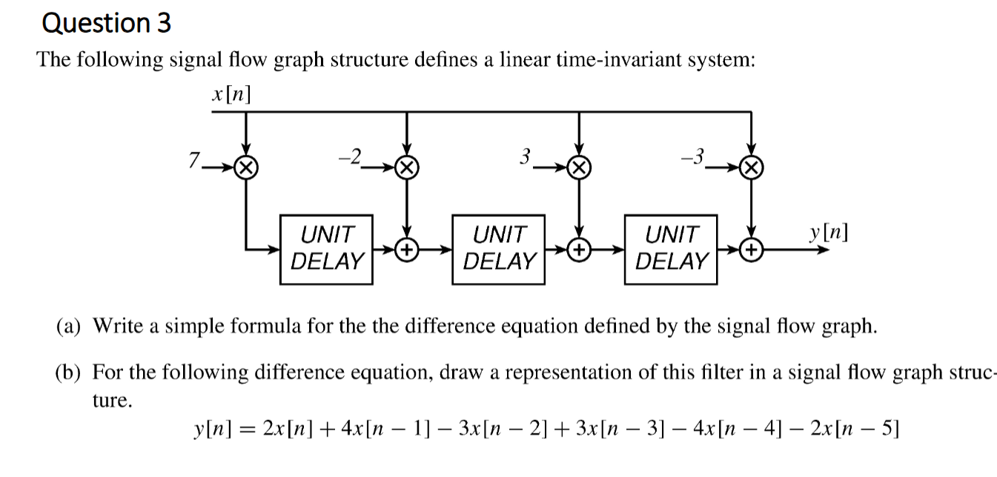

Slide 13
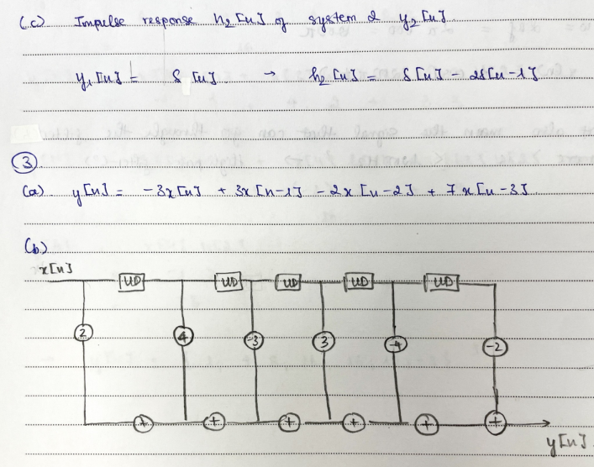

Slide 14
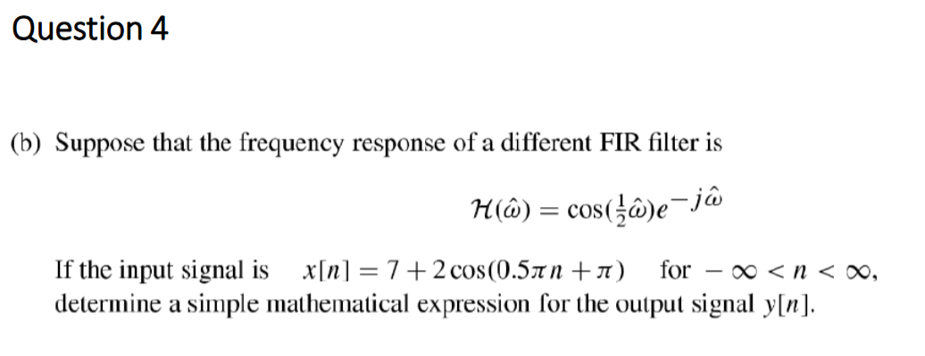

Slide 15
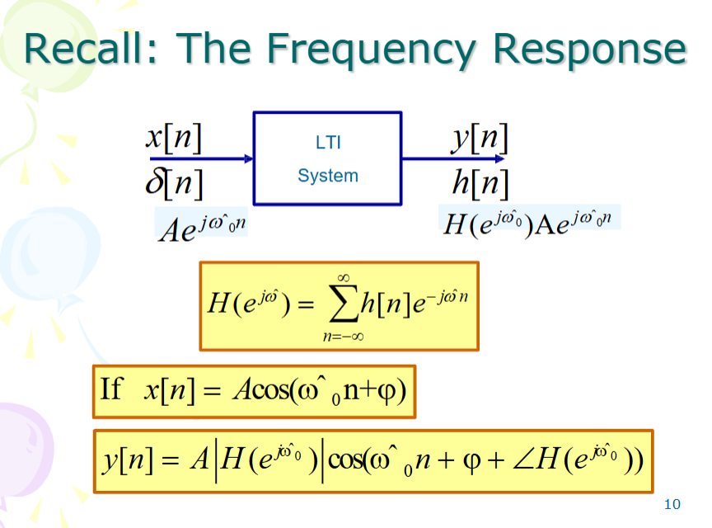

Slide 16
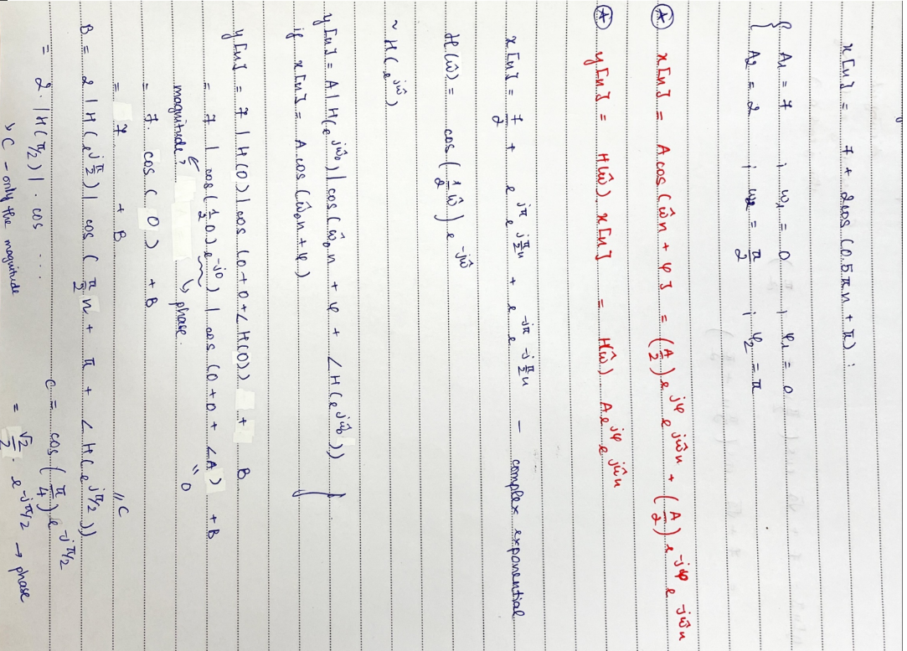

Slide 17
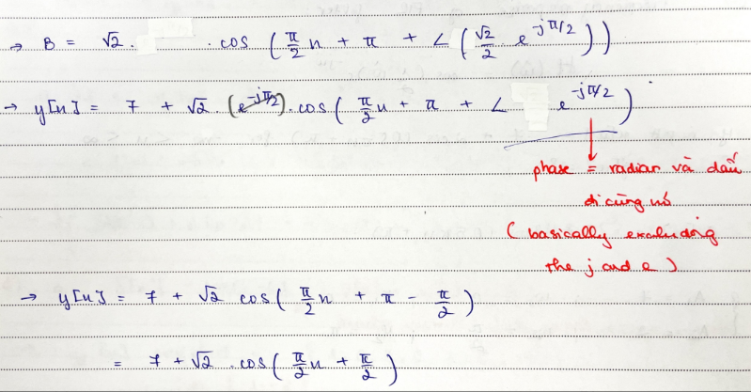

Slide 18
